Slide 1

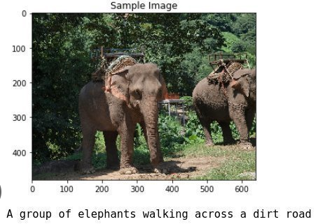
M.Hasaan.Raza (Bsee20016)
M.Rabeet Akbar (Bsee20042)
Ahmad Ali (Bsee20046)
Group:8

Slide 2

OBJECTIVE:Develop a model to generate descriptive captions for images.
Approach: Combine Convolutional Neural Networks (CNN) with Recurrent Neural Networks (RNN) using Long Short-Term Memory (LSTM) units.

Slide 3
Dataset Overview
Data Size:1.04 GB
Context:Images in .jpg format and corresponding captions in .txt files.
Structure:Each caption is associated with an image filename, separated by a comma.

Slide 4
Pre-processing Steps
Image Transformations:
- Resize to 224x224 pixels
- Convert to tensor
- Normalize with ImageNet statistics
Custom Collate Function:
Pads captions for batch processing
Stacks images into a single tensor
Captures caption lengths

Slide 5
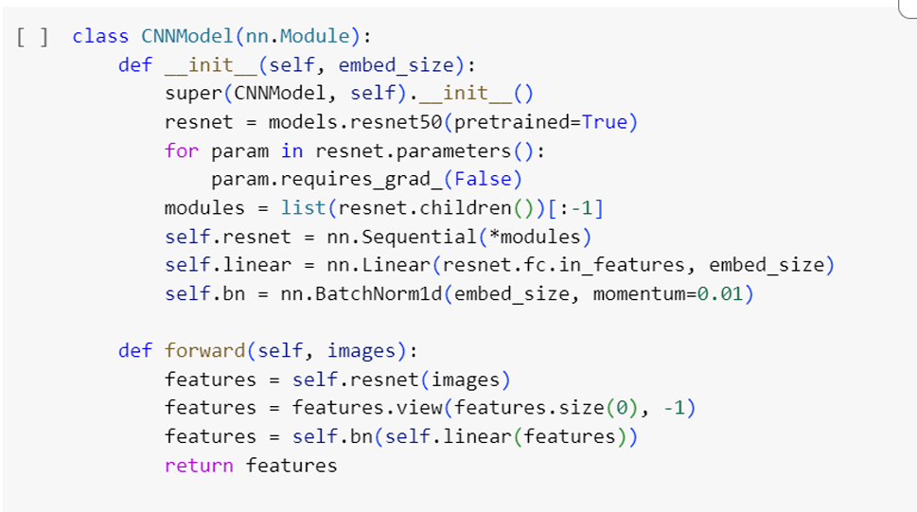
CNN Component
Architecture:ResNet-50
Modifications:
Removed final fully connected layer
Added linear layer and batch normalization
Purpose:Extract high-level image features

Slide 6
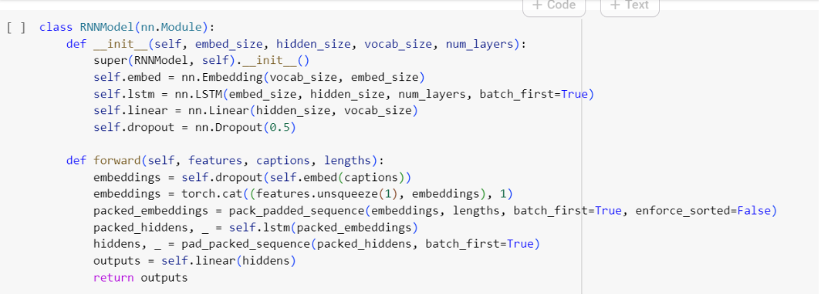
RNN Component
Architecture: LSTM
Layers:
Embedding layer for word embedding.
LSTM layer for sequence processing.
Fully connected layer for generating word probabilities.

Slide 7
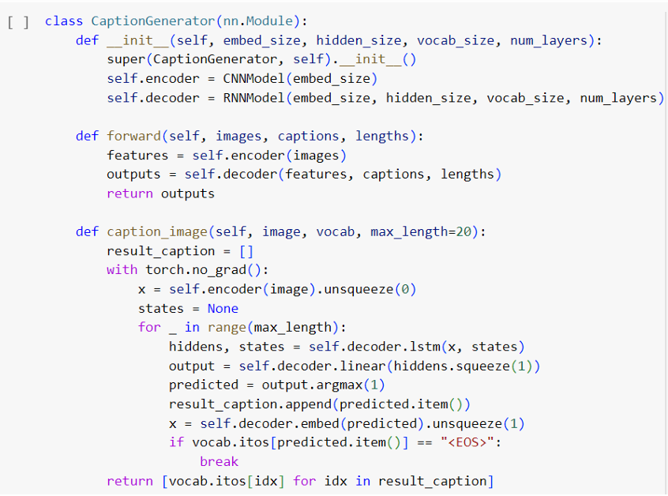
Combined Model Architecture
Integration: Combines CNN for image features and RNN for caption generation.
Workflow: CNN extracts image features.
RNN generates captions based on features and previous words.

Slide 8
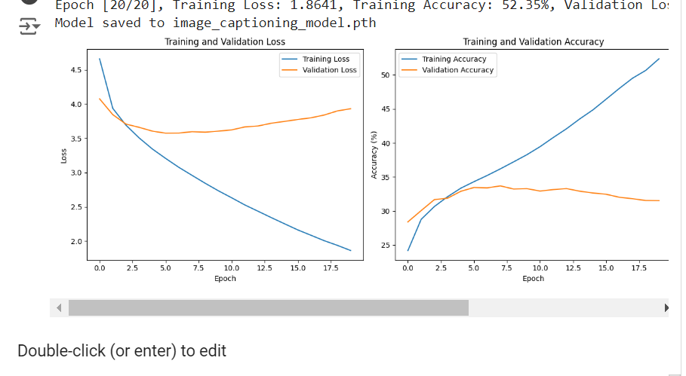
Training Configuration
Hyper parameters
Learning Rate: 0.001
Batch Size: 32
Number of Epochs: 10

Slide 9
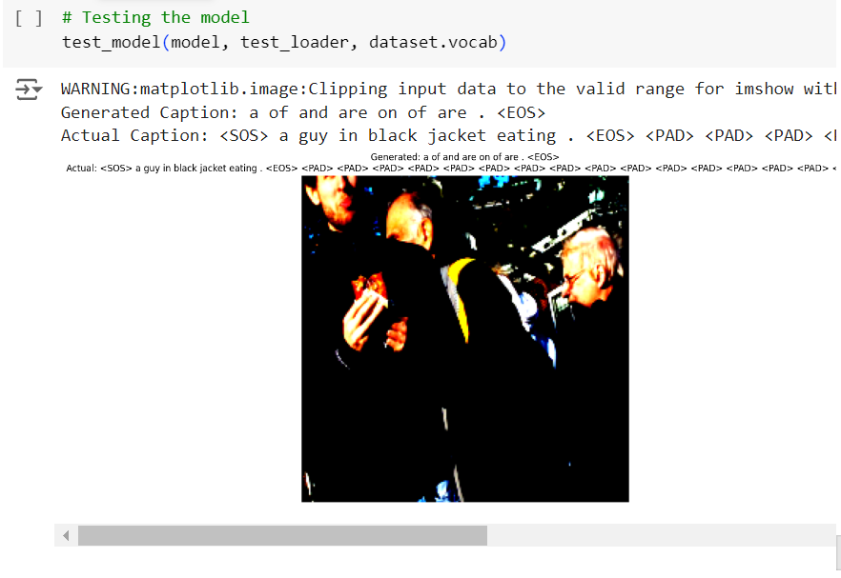
Model Performance and Challenges
Initial Results:
Demonstrated reasonable capability in generating captions.
Challenges:
Sufficient epochs for full convergence
Limited dataset size restricting generalization
Complexity of the image captioning task

Slide 10
Conclusion and Future Work
Summary:
Effective integration of CNN and RNN
Promising initial results despite limitations
Future work:
Ease number of epochs for better convergence.
Expand dataset for improved generalization.
Experiment with more complex models or architectures.

Slide 11


